Slide 1



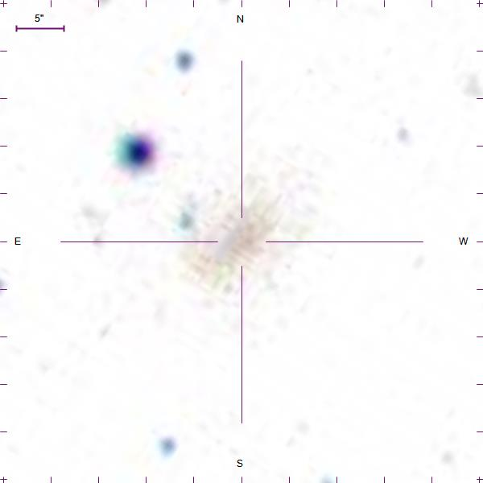
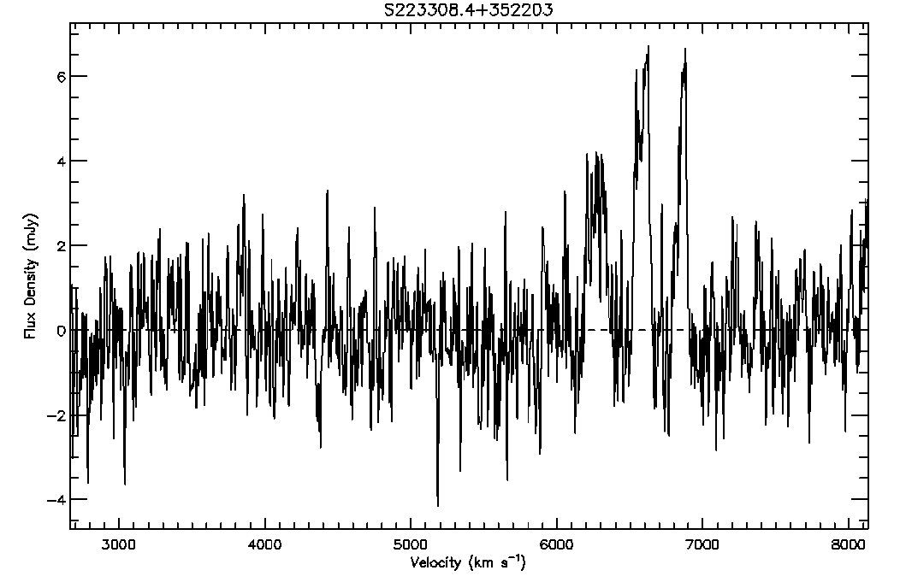
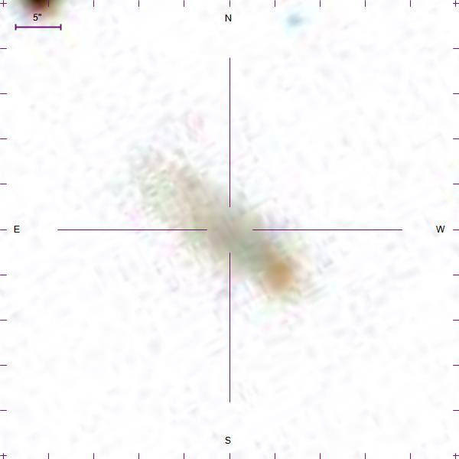
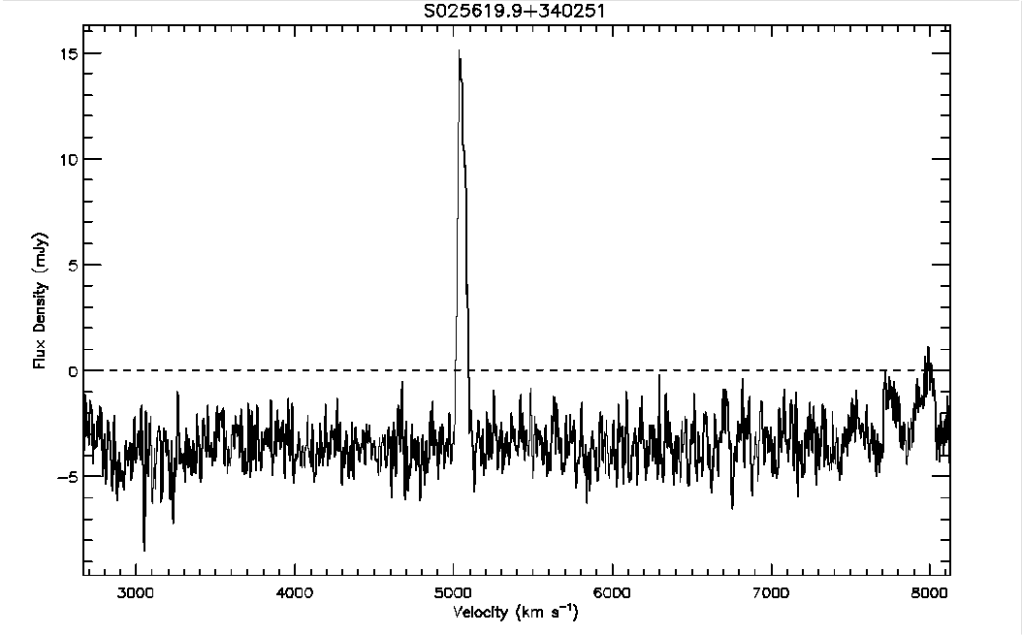
The Arecibo Pisces-Perseus Supercluster Survey: Declination Strip 35
Chelsey McMichael¹, J. Ribaudo¹, R. Koopmann², M. Haynes³, APPSS Team, Undergraduate ALFALFA Team, ALFALFA Team, ¹Utica College, ²Union College, ³Cornell University
The Arecibo Pisces-Perseus Supercluster Survey (APPSS) will provide strong observational constraints on the mass-infall rate onto the main filament of the Pisces-Perseus Supercluster. The survey data consist of HI emission-line spectra of cluster galaxy candidates, obtained primarily at the Arecibo Observatory (with ALFA as part of the ALFALFA Survey and with the L-Band Wide receiver as part of APPSS observations). Here we present the details of the data reduction process and spectral-analysis techniques used to determine if a galaxy candidate is at a velocity consistent with the Supercluster, as well as the detected HI-flux and rotational velocity of the galaxy, which will be used to estimate the corresponding HI-mass. We discuss the results of a preliminary analysis on a subset of the APPSS sample, corresponding to 98 galaxies located within ~1.5° of DEC = +35.0°, with 65 possible detections. We also highlight several interesting emission-line features and galaxies discovered during the reduction and analysis process and layout the future of the APPSS project.
This work has been supported by NSF grants AST-1211005 and AST-1637339.
ABSTRACT
Figure Above: Graph includes galaxies known to be in the Pisces Perseus Supercluster and detections from the ALFALFA observatory. Detections from declination strip 35 are marked in red and the non-detections are marked in gray. AGC data completely shown.
Figure Below: Comparing two data sets reveals the mature of both samples. Declination strip 35 has a propensity to have a systemic velocity around 5,000 km/s. ALFALFA detections tend to be greater in systemic velocity which is suspected.
The Arecibo Pisces-Perseus Supercluster Survey goal is to determine the rate at which galaxies are falling into the Pisces Perseus Supercluster
Sources mainly acquired from the Arecibo observatory. Using the L-Band wide array, radio waves between 1.15 and 1.73 GHz can be detected
Galaxy candidates are reduced in order to achieve this goal and recognize these galaxies as galaxies existing in the Supercluster
Rather than detecting light of stars within a galaxy, the APPSS Survey identifies light emitted by hydrogen atoms within a galaxy candidate
Figure 1. consists of loaded source data. A proper measurement can only be made with a baseline to the data. The area of the spectrum is selected and marked in blue. These areas are noise, not including RFI or sources. A polynomial fit is calculated, giving an RMS for each fit.
Figure 2. displays the beginning steps of measuring a detection. There are two fit options: gaussian or 2-horned profile. A box is centered on a source and the box can vary in size if necessary. It is important to include the whole source as well as the baseline, but the box should be small enough to show the detailed of a source.
Figure 3. shows the final fit. Once the fit on both the right and left edge of emission are approved, the code prints the calculated parameters. The information recorded can be saved in idl.
There seems to be multiple detections in the sample. The peak nearest 7000 km/s could be harmonic beeper interference
The SDSS catalog shows a faint galaxy
This peculiar galaxy has a prominent signal peaking around 5000 km/s, it was difficult to determine whether the RFI required a gaussian or two-peaked fit
The SDSS catalog reveals it is not an elliptical galaxy, thus it is more likely to be a two-peaked fit

